Slide 1
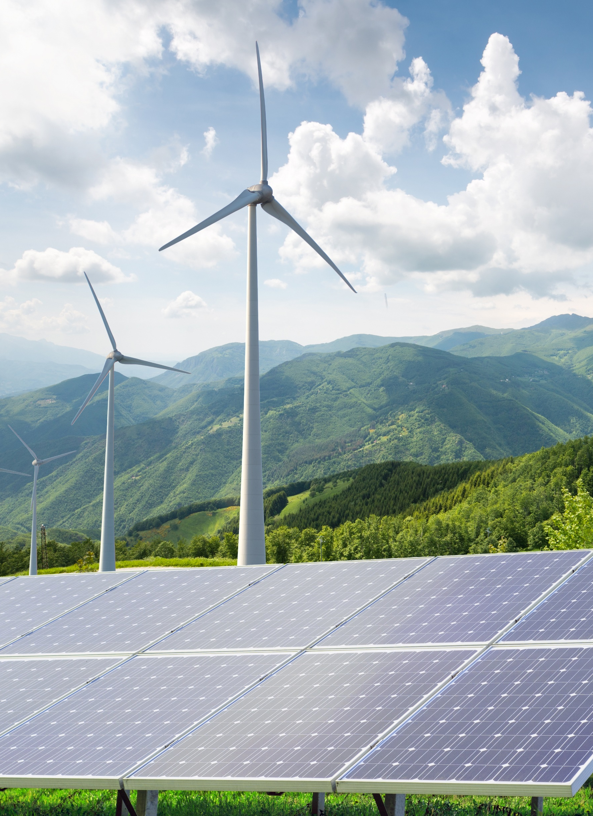

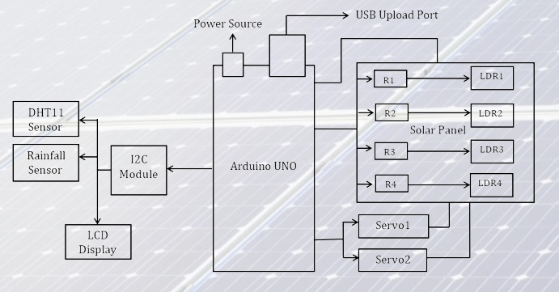
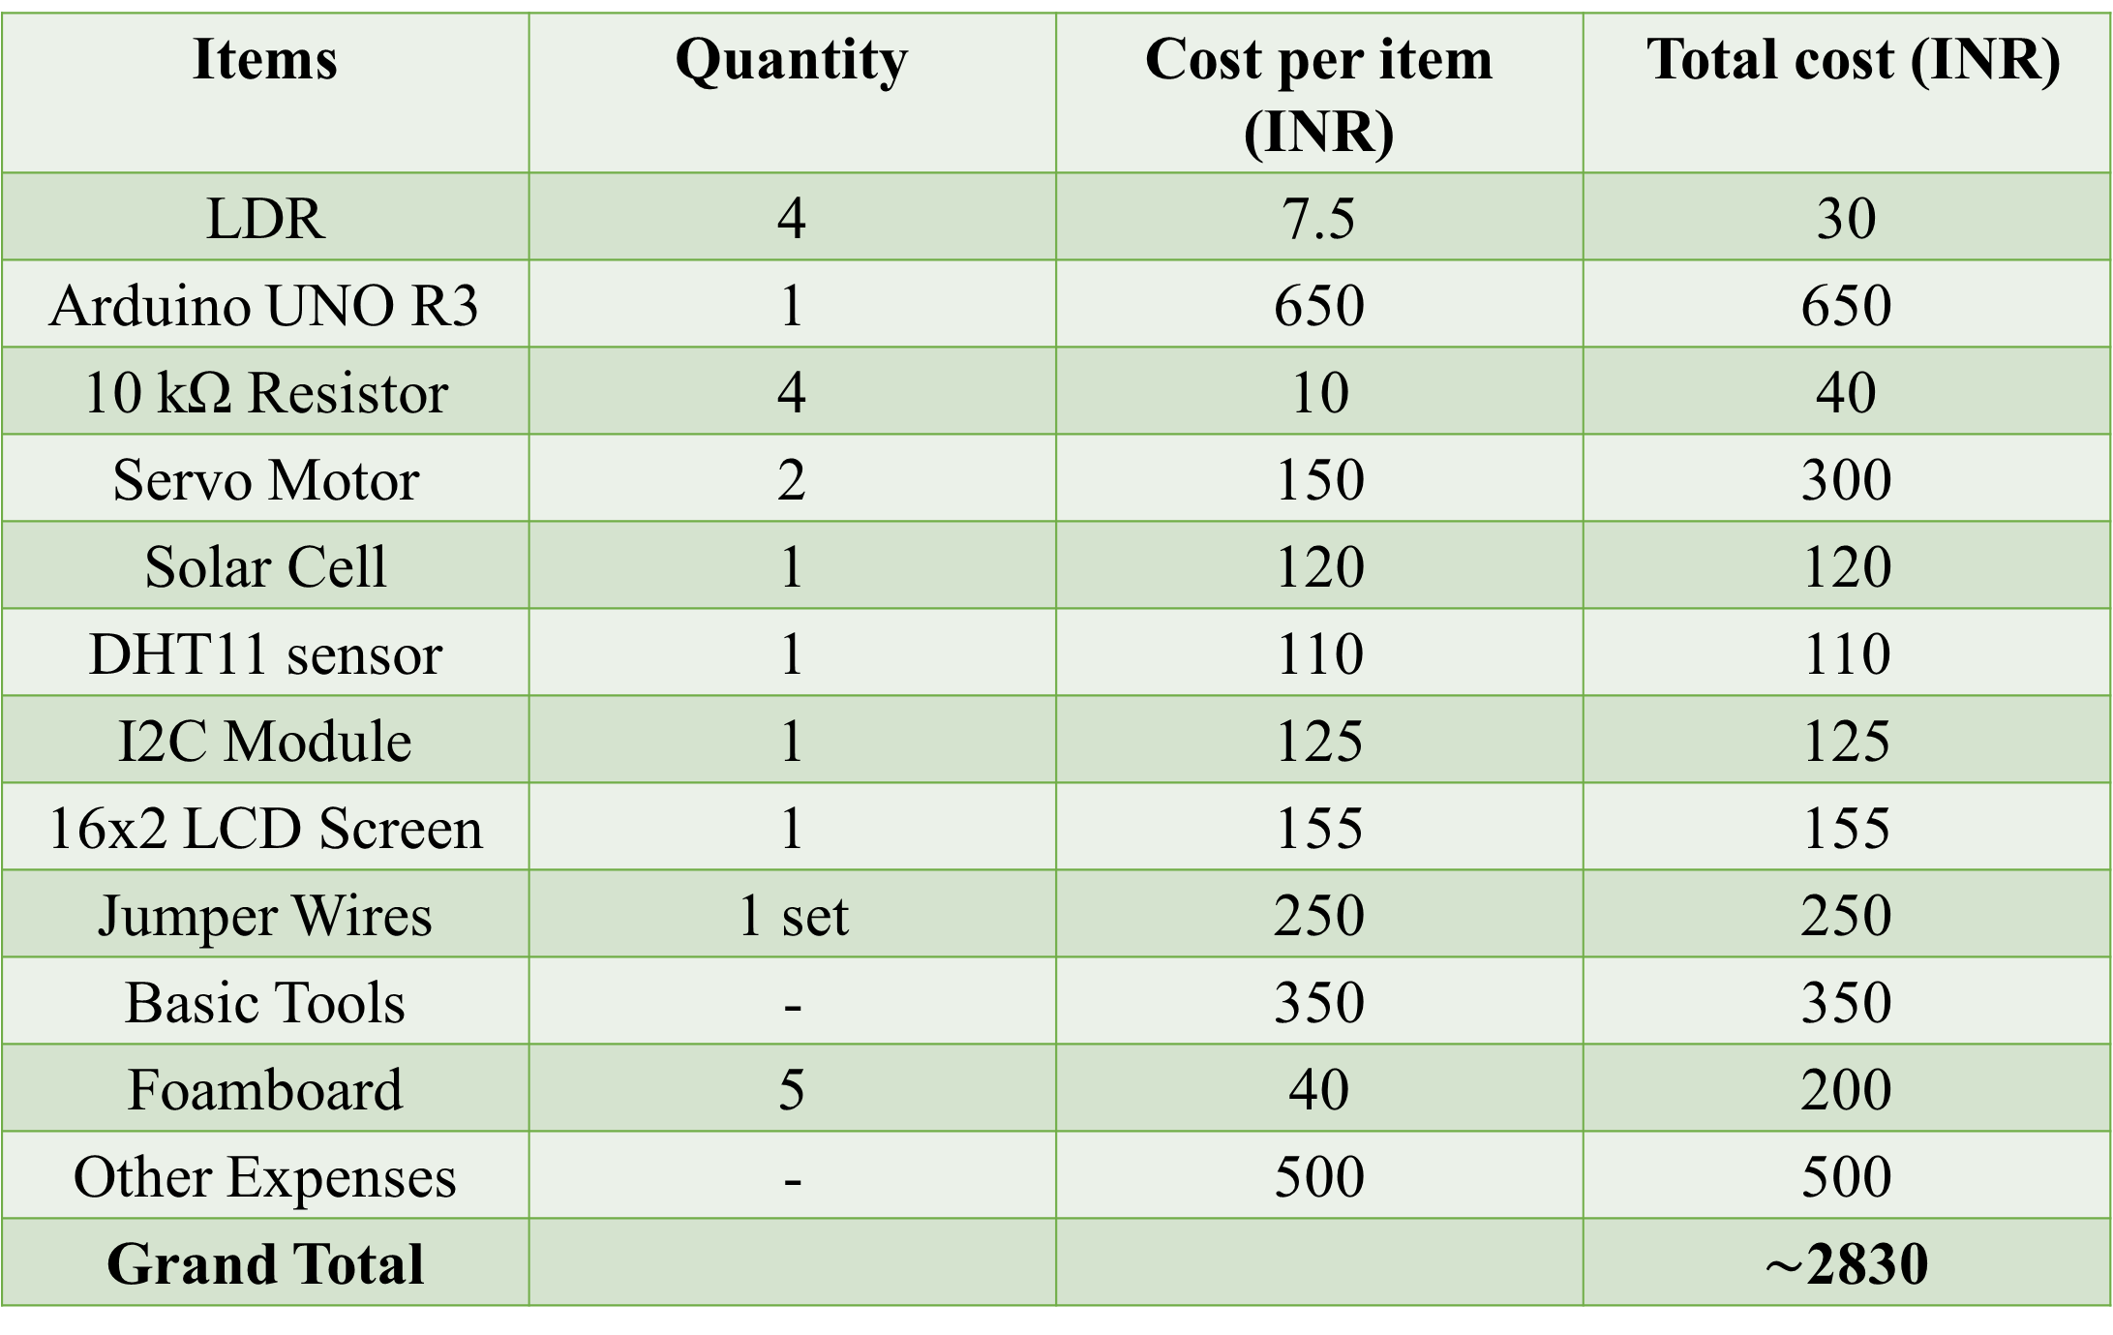
SOLACE : A DUAL-AXIS SOLAR TRACKER WITH WEATHER MONITORING STATION
GROUP NO. 6 : MECHANICAL ENGINEERING (Section-A)
ANKUR DAS: Ideation, Prototype & Poster Design, Assembly
PRANAV JADHAL: Ideation, Hardware, Algorithm Development
SREE RAM PM: Prototype Design, Assembly, Programming
PANCHAM DEVAM: Hardware, Theory & Data Analysis
JOHAN SURESH: Hardware, Budget & Cost Analysis
LAKSHYA TIWARI: Pros & Cons Analysis, Value Proposition SRIVISHNU: Documentation, Overall Presentation Design
PROJECT GOALS & OBJECTIVES
WORKING PRINCIPLE & OPERATING MECHANISM
To optimize the performance of a solar PV system through continuous tracking of the position of the sun and simultaneously adjusting the orientation of the panels to ensure maximum capture of solar radiation.
To monitor weather conditions such as temperature, humidity and rainfall which ensures longevity of the system thereby significantly reducing maintenance costs
To creates awareness and promote sustainability by encouraging the use of solar energy
Based on principle of maximum power point tracking (MPPT)
Solar radiation is detected by LDRs which relays analog signals to the Arduino which is then converted to digital signals and processed by the Arduino program.
The processed data controls servo motors that adjust the direction of the solar panel.
The DHT11 sensor and rainfall sensor are connected to the Arduino using the I2C module for data communication which can be then visualized via an Arduino algorithm and Matplotlib.
CHALLENGES FACED BY CONVENTIONAL PANELS
METHODOLOGY
Limited efficiency leading to reduced energy output
Fixed orientation leading to potential shading issues
Prone to damage under extreme-weather conditions
Space-consuming which increases installation expenses
Ideation & Design
Assembly-Mechanical & Electrical
Development of Arduino Programs & Algorithms
Data Logging & Visualization
Testing & Calibration
HOW DOES THIS PROJECT ADDRESS THESE CHALLENGES?
TIMEFRAME OF PROJECT
Ensures that the incident solar radiation is always perpendicular to the panel thereby increasing output.
Follows the position of the sun continuously reducing chances of shading or obstacles.
Real-time weather monitor alerts the user regarding extreme weather thereby triggering shutdown of system.
Higher energy density than conventional panels.
Planning and Research: 7-8 days
Hardware Assembly: 5-6 days
Program Development: 1 day
Testing and Debugging: 1 day
Documentation and Finalization: 2-3 days
BUDGET & COST BREAKDOWN
SCHEMATIC BLOCK DIAGRAM
Items | Quantity | Cost per item (INR) | Total cost (INR)
LDR | 4 | 7.5 | 30
Arduino UNO R3 | 1 | 650 | 650
10 kΩ Resistor | 4 | 10 | 40
Servo Motor | 2 | 150 | 300
Solar Cell | 1 | 120 | 120
DHT11 sensor | 1 | 110 | 110
I2C Module | 1 | 125 | 125
16x2 LCD Screen | 1 | 155 | 155
Jumper Wires | 1 set | 250 | 250
Basic Tools | - | 350 | 350
Foamboard | 5 | 40 | 200
Other Expenses | - | 500 | 500
Grand Total |  |  | $\sim$2830
X cc
CONCLUSION & RESULTS
Enhancing of overall energy output
Improving the reliability on solar energy
Promising a sustainable future
Higher Return on Investment (ROI)
Utilizing and allocating energy resources optimally
Adaptability to diverse locations

